Slide 1
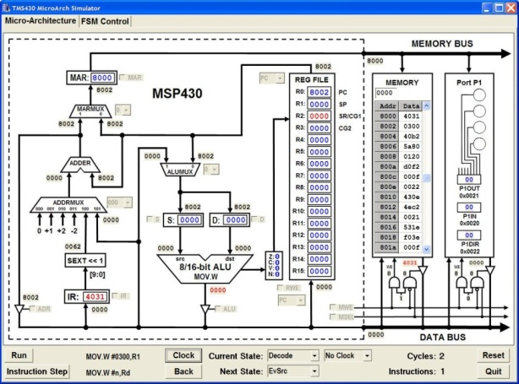
S04: MSP430 Microarchitecture
Required: PM: Ch 8.1-3, pgs 109-114 Code: Ch 17, pgs 206-237 Recommended: Wiki: Microarchitecture Wiki: Addressing_mode Wiki: Three-state logic
Lab: Microarch

Slide 2
CS 224
Chapter | Project | Homework
S00: Introduction
Unit 1: Digital Logic
S01: Data Types S02: Digital Logic | L01: Warm-up L02: FSM | HW01 HW02
Unit 2: ISA
S03: ISA S04: Microarchitecture S05: Stacks / Interrupts S06: Assembly | L03: Blinky L04: Microarch L05b: Traffic Light L06a: Morse Code | HW03 HW04 HW05 HW06
Unit 3: C
S07: C Language S08: Pointers S09: Structs S10: I/O | L07b: Morse II L08a: Life L09b: Snake | HW07 HW08 HW09 HW10

Slide 3
Learning Outcomes…
After discussing microarchitecture and studying the reading assignments, you should be able to:
Explain what is a computer microarchitecture.
Describe how memory-mapped I/O is implemented.
Program digital I/O using computer ports.
List the addressing modes of the MSP430.
Identify MSP430 microarchitecture components.
Explain how a microarchitecture executes computer instructions.
Identify multiplexor, decoder, driver, ALU, and register circuitry.
Explain program counter, stack pointer, and condition code registers.
Explain the difference between clock cycles and instruction steps.

Slide 4
Topics to Cover…
Memory Mapped I/O
I/O Ports
Microarchitecture
Instruction Cycle
Fetch
Decode
Evaluate operands
Execute
Store
Operand Addressing Modes
Register
Indirect
Symbolic

Slide 5
Terms…
Absolute Addressing – direct addressing of memory (immutable).
Address Space – number of addressable memory locations.
Addressability – size of smallest addressable memory location.
Arithmetic Logic Unit (ALU) – combinational logic that performs arithmetic and logical operations.
Bus – physical connection shared by multiple hardware components.
Finite State Machine – finite set of states than transition from a current to next state by some triggering condition.
Indexed Addressing – final address is offset added to base address.
Instruction Phases – steps used by a FSM to execute an instruction.
Memory Mapped I/O – memory locations used to input/output.
Microarchitecture – physical implementation of an ISA.
Read-Before-Write – access memory before changing with write.
Relative Addressing – address is relative to current memory position.

Slide 6
Memory Mapped I/O

Slide 7


Memory Mapped I/O
Memory Mapped I/O
15 | 14 | 13 | 12 | 11 | 10 | 9 | 8 | 7 | 6 | 5 | 4 | 3 | 2 | 1 | 0
Memory Address Bus (A[15:0])
1 | 1 | 0 | 0 | 1 | 0 | 0 | 1 | 1 | 1 | 1 | 1 | 1 | 1 | 1 | 0
0 | 0 | 0 | 0 | 0 | 0 | 0 | 1 | 1 | 1 | 1 | 1 | 1 | 1 | 1 | 0
Bits A[15:9]
Device 0x0000
...
512 Peripherals
...
9 to 512 Decoder
Bits A[8:0]
Device 0x01fe
High (1) if and only if bits 9-15 are low (0).
Device 0x01ff
Memory CS
High (1) if any of bits 9-15 are high (1).

Slide 8
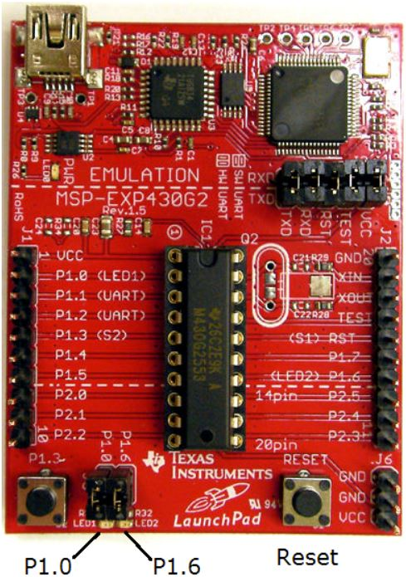
MSP430 P1/P2 Port Registers
Memory Mapped I/O
Memory Mapped I/O
Ports connect CPU to external world
Ports are 8 bit memory locations (R/W enabled)
Each bit independently programmable for Input or Output (I/O)
Edge-selectable input interrupt capability (P1/P2)
0xFFFF
Interrupt Vectors
FLASH
Main Memory
O
I
0xF800
I
I
I
I
I
O
0x0400
P1DIR | 0x0022 | 0000 0000
P1OUT | 0x0021 | 0000 0000
P1IN | 0x0020 | 0000 0000
bis.b #0x41,&P1DIR
bis.b #0x01,&P1OUT
0x03FF
RAM
0x0200
0100 0001
0x01FF
Peripherals
Ports
SFR’s
0100 0000
xor.b #0x41,&P1OUT
0000 0001
0x0000
MSPG2553

Slide 9
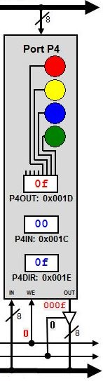
Digital Port Input/Output
Memory Mapped I/O
Direction Register (PxDIR):
Bit = 0: the individual port pin is set as an input (default)
Bit = 1: the individual port pin is set as an output
Input Register (PxIN):
Bit = 1: The input port pin is high
Bit = 0: The input port pin is low
Output Register (PxOUT):
Bit = 1: The output port pin is set high;
Bit = 0: The output port pin is set low.
Note: the PxOUT is a read-write register which means previously written values can be read, modified, and written back

Slide 10
Quiz 4.1
Four LEDs are attached to Port 4, bits 0 thru 3. Indicate which LEDs are ON/OFF after each instruction is executed.
P4.3
P4.2
P4.1
P4.7
P4.0
P4.6
P4.5
P4.4
mov.b #0x0f,&P4DIR
and.b #0xf0,&P4OUT
bis.b #0x09,&P4OUT
xor.b #0x0f,&P4OUT
bic.b #0x06,&P4OUT
add.b #0x03,&P4OUT

Slide 11
Microarchitecture

Slide 12
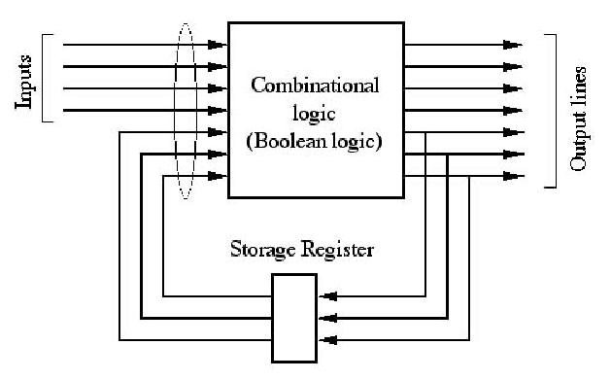
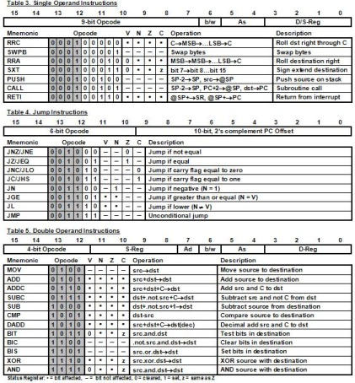
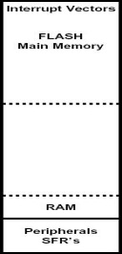
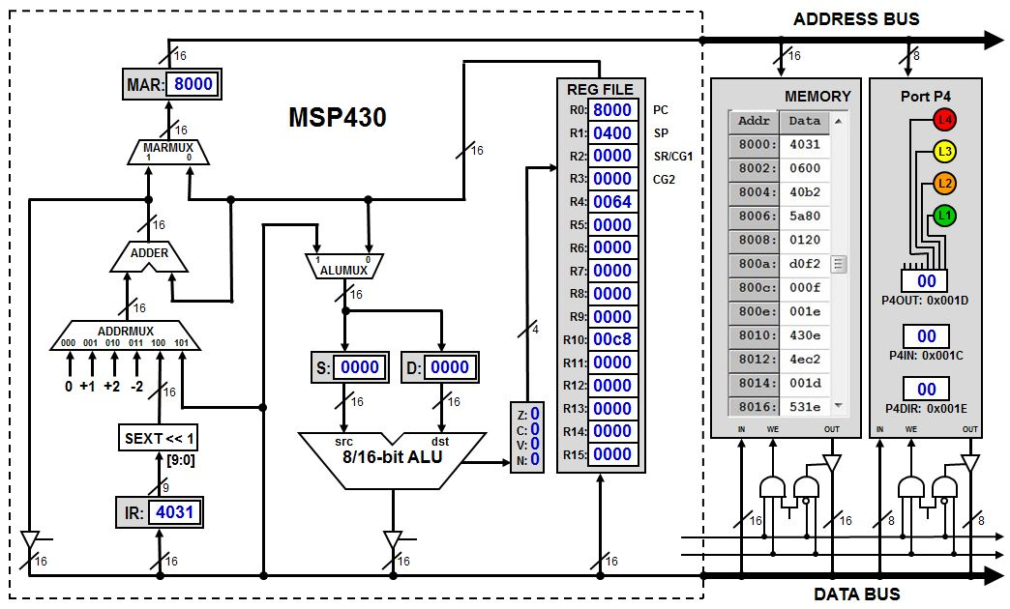


Microarchitecture Journey
Microarchitecture
ISA
we
d
Finite State Machine
Register
we
Register
2-to-4
Decoder
we
4-to 1
Multiplexor
q
Register
we
Register
we
d
a₁ a₀
Storage Devices
q
we
q
Sequential Logic
Microarchitecture
A
B
A
W
B
X
S
Y
a
C
Z
b
Combinational Logic
NOR
Complementary Logic
Transistor

Slide 13
Microarchitecture
Microarchitecture
The Instruction Set Architecture (ISA) defines the processor instruction set, processor registers, address and data formats
The processor as seen by an assembly language programmer.
The microarchitecture implements the ISA.
Gates, registers, ALUs, clocks
Data and control paths
Microarchitectures differentiate themselves by:
Chip area/cost
Power consumption
Logic complexity
Manufacturability
Ease of debugging
Testability

Slide 14
Lab 4: MSP430 Microarchitecture
MSP430 Microarchitecture
MSP430 Microarchitecture Simulator:
Use the MSP430 Microarchitecture Simulator to create a machine that implements the Texas Instruments MSP430 ISA.
Generate a Finite State Machine (FSM) for fetch, decode, evaluate source, evaluate destination, execute, and store cycles of MSP430 instructions.
Execute a program that displays an incrementing counter in the simulator LEDs.
Learning Objectives:
Learn how a microarchitecture executes computer instructions.
Learn about multiplexor, decoder, driver, ALU, and register circuitry.
Learn about program counter, stack pointer, and condition code registers.
Understand better the difference between clock cycles and instruction steps.

Slide 15
MSP430 Machine Code
MSP430 Microarchitecture
;***********************************************************
; MSP430 Micro-Architecture Simulator Code
;
; Description: Display an incrementing counter in LEDs.
;***********************************************************
.cdecls C,"msp430.h"
.text
8000: 4031 0600 RESET: mov.w #0x0600,r1 ; init stack pointer
8004: 40b2 5a80 0120 mov.w #0x5A80,&WDTCTL ; stop WDT
800a: d0f2 000f 0022 bis.b #0x0f,&P1DIR ; set P1.0-3 output
8010: 430e mov.w #0,r14
8012: 4ec2 0021 loop: mov.b r14,&P1OUT ; output P1.0-3
8016: 531e add.w #1,r14
8018: f03e 000f and.w #0x000f,r14 ; mask counter
801c: 401f 000e mov.w delay,r15 ; r15 = delay
8020: 120f push r15 ; push delay on stack
8022: 8391 0000 wait: sub.w #1,0(sp) ; decrement delay count
8026: 23fd jne wait ; delay over?
8028: 41ef mov.w @sp+,r15 ; y, restore r15
802a: 3ff3 jmp loop ; repeat
802c: 0002 delay: .word 2 ; delay count
.sect ".reset" ; RESET Vector
.word RESET ; NMI
.end
Memory Address
Memory Data

Slide 16
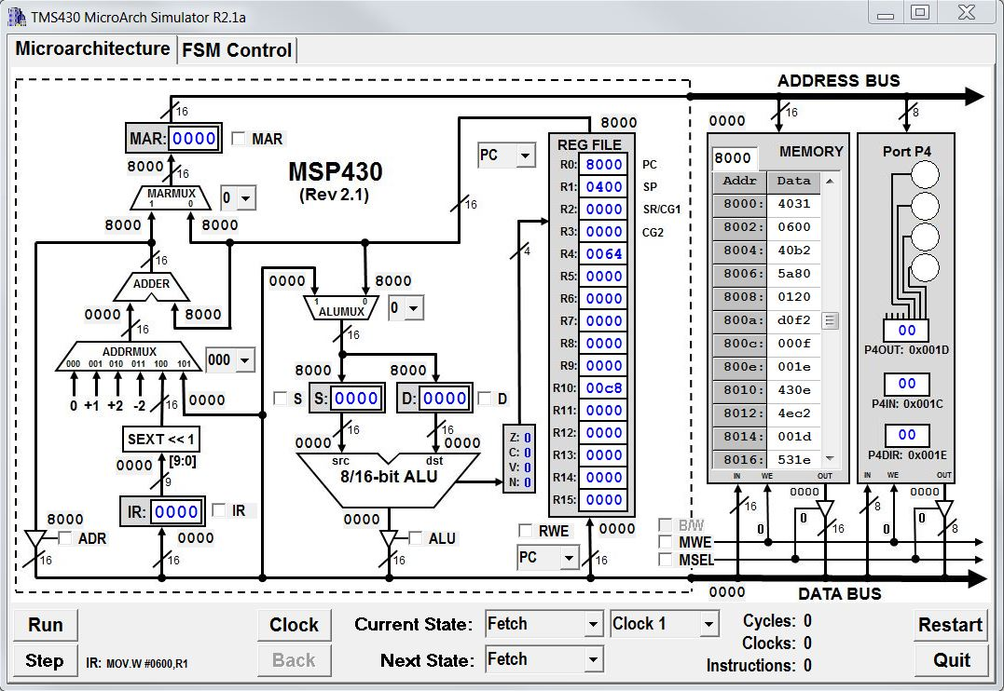
MSP430 Microarchitecture Simulator
MSP430 Microarchitecture

Slide 17
MSP430 Microarchitecture

Slide 18
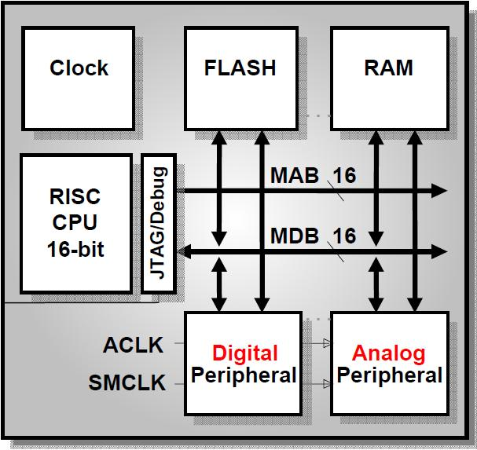
MSP430 Microarchitecture
MSP430 Microarchitecture
Control Logic
(Finite State Machine)
Memory
(Address Space)
Clocks
ALU
Input/Output
MSP430 MPU
16 16-bit Registers

Slide 19
Quiz 4.2
Match the following terms:
ALU
Clocks
Control
I/O
Memory
Peripherals
Registers
Address space
Execution speed
External devices
Fast memory
Finite State Machine
Memory mapped
Word length

Slide 20
The Instruction Cycle
Instruction Cycle
INSTRUCTION FETCH
Obtain the next instruction from memory
DECODE
Examine the instruction, and determine how to execute it
SOURCE OPERAND FETCH
Load source operand
DESTINATION OPERAND FETCH
Load destination operand
EXECUTE
Carry out the execution of the instruction
STORE RESULT
Store the result in the designated destination
Not all instructions require all six phases

Slide 21
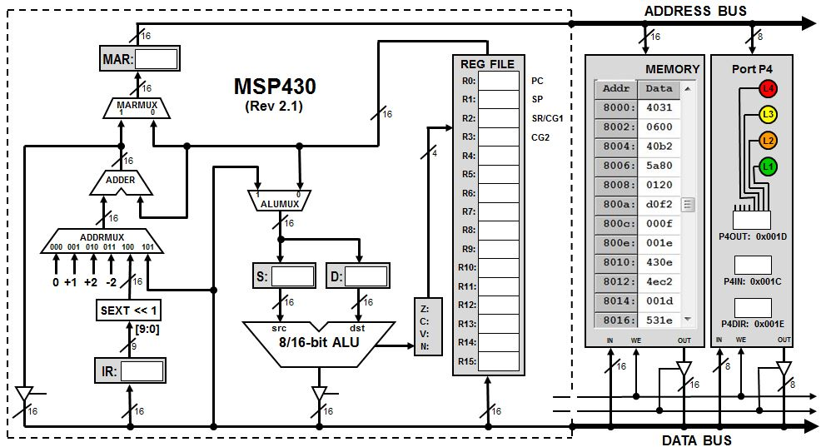
Fetching an Instruction
Fetch Cycle
PC can be incremented anytime during the Fetch phase
PC
❶
❷

Slide 22
Addressing Modes
Addressing Modes
The MSP430 has four basic addressing modes:
00 = Rs - Register
01 = x(Rs) - Indexed Register
10 = @Rs - Register Indirect (source only)
11 = @Rs+ - Indirect Auto-increment (source only)
When used in combination with registers R0-R3, three additional source addressing modes are available:
label - PC Relative, x(PC)
&label – Absolute, x(SR)
#n – Immediate, @PC+ (source only)

Slide 23
Quiz 4.3
Match the following source operand modes:
add.w tab(r10),r9
and.w &mask,r12
bis.b #0x08,r6
mov.b cnt,r11
mov.w r4,r5
mov.w #100,r14
sub.w @r4+,r5
xor.b @r8,r15
Absolute
Constant
Immediate
Indexed register
Indirect auto-increment
Indirect register
Register
Symbolic

Slide 24
Addressing Mode Demo
Addressing Modes
8000: 540A
8002: 541A 0006
8006: 542A
8008: 543A
800a: 501A 81f4
800e: 521A 0200
8012: 503A 0064
8016: 531A
8018: 1210 0004
801c: 3ff1
.text
start:
add.w r4,r10 ; r4 += r10;
add.w 6(r4),r10 ; r10 += M[r4+6];
add.w @r4,r10 ; r10 += M[r4];
add.w @r4+,r10 ; r10 += M[r4++];
add.w cnt,r10 ; r10 += cnt;
add.w &cnt,r10 ; r10 += cnt;
add.w #100,r10 ; r10 += 100;
add.w #1,r10 ; r10++;
push cnt ; M[--r1] = cnt;
jmp start

Slide 25
00 = Register Mode
Addressing Modes
add.w r4,r10 ; r10 += r4
0x0000
Memory
Address Bus
CPU
Data Bus (1 cycle)
0x540a
IR
Registers
PC
0x540a
+2
PC
PC
R4
ADDER
R10
ALU
0xFFFF

Slide 26
Source: Register Mode – Rs
Evaluate Source Operand
Select the source register
Rs
❶

Slide 27
01 = Indexed Mode
Addressing Modes
add.w 6(r4),r10 ; r10 += M[r4+6]
0x0000
Memory
Address Bus
CPU
Data Bus (1 cycle)
0x541a
IR
Registers
+2
PC
0x541a
+2
PC
PC
0x0006
Data Bus (+1 cycle)
PC
R4
Address Bus
ADDER
R10
Data Bus (+1 cycle)
ALU
0xFFFF

Slide 28
Source: Indexed Mode – x(Rs)
Evaluate Source Operand
PC incremented at end of phase
❶
PC
PC
Rs
Use PC to obtain index, use Rs for base register
❹
❷
❸

Slide 29
10 = Indirect Register Mode
Addressing Modes
add.w @r4,r10 ; r10 = M[r4]
0x0000
Memory
Address Bus
CPU
Data Bus (1 cycle)
0x542a
IR
Registers
PC
0x542a
+2
PC
PC
R4
Address Bus
ADDER
R10
Data Bus (+1 cycle)
ALU
0xFFFF

Slide 30
Source: Indirect Mode – @Rs
Evaluate Source Operand
❶
Rs
❷

Slide 31
Addressing Modes
11 = Indirect Auto-increment Mode
add.w @r4+,r10 ; r10 += M[r4++]
0x0000
Memory
Address Bus
CPU
Data Bus (1 cycle)
0x543a
IR
Registers
PC
0x543a
+2
PC
PC
Address Bus
0002
R4
ADDER
R10
Data Bus (+1 cycle)
ALU
0xFFFF

Slide 32
Source: Indirect Auto Mode – @Rs+
Evaluate Source Operand
❶
Rs
Increment by 1 (.b) or 2 (.w)
❷

Slide 33
Addressing Modes
01 w/R0 = Symbolic Mode
add.w cnt,r10 ; r10 += M[cnt]
0x0000
Memory
Address Bus
CPU
Data Bus (1 cycle)
0x501a
IR
Registers
+2
PC
0x501a
PC
+2
PC
PC
0x000c
PC
Data Bus (+1 cycle)
Address Bus
ADDER
cnt
R10
Data Bus (+1 cycle)
ALU
*Also called PC Relative address mode
0xFFFF

Slide 34
Source: Symbolic Mode – label
Evaluate Source Operand
PC incremented at end of phase
❶
PC
PC
PC
Use PC to obtain relative index and for base register
❹
❷
❸

Slide 35
Quiz 4.4
Present the destination operand of the following instruction to the ALU:
add.w r4,cnt ; M[cnt] += r4
0x0000
Memory
CPU
0x5480
IR
Registers
PC
PC
0x5480
PC
PC
PC
0x0218
R4
ADDER
cnt
ALU
0xFFFF

Slide 36
Addressing Modes
01 w/R2 = Absolute Mode
add.w &cnt,r10 ; r10 += M[cnt]
0x0000
Memory
Address Bus
CPU
Data Bus (1 cycle)
0x521a
IR
Registers
+2
PC
0x521a
+2
PC
PC
0xc018
Data Bus (+1 cycle)
PC
0000
Address Bus
ADDER
cnt
R10
Data Bus (+1 cycle)
ALU
0xFFFF

Slide 37
Source: Absolute Mode – &Address
Evaluate Source Operand
PC can be incremented anytime during the phase
❶
PC
#0
Use PC to obtain absolute address, use #0 for base register
❷
❸

Slide 38
Addressing Modes
11 w/R0 = Immediate Mode
add.w #100,r10 ; r10 += 0x0064
0x0000
Memory
Address Bus
CPU
Data Bus (1 cycle)
0x503a
IR
Registers
+2
PC
0x503a
+2
PC
PC
0x0064
PC
Data Bus (+1 cycle)
ADDER
R10
ALU
0xFFFF

Slide 39
Source: Immediate Mode – #n
Evaluate Source Operand
PC can be incremented anytime during the phase
❶
PC
❷

Slide 40
MSP430 Source Constants
Evaluate Source Operand
To improve code efficiency, the MSP430 "hardwires" six register/addressing mode combinations to commonly used source values:
#0 - R3 in register mode (00)
#1 - R3 in indexed mode (01)
#2 - R3 in indirect mode (10)
#-1 - R3 in indirect auto-increment mode (11)
#4 - R2 in indirect mode (10)
#8 - R2 in indirect auto-increment mode (11)
Eliminates the need to use a memory location for the immediate value - commonly reduces code size by 30%.

Slide 41
Addressing Modes
Constant Generator
add.w #1,r10 ; r10 += 1
0x0000
Memory
Address Bus
CPU
Data Bus (1 cycle)
0x531a
IR
Registers
PC
0x531a
+2
PC
0000
0001
0002
0004
0008
ffff
PC
ADDER
R10
ALU
0xFFFF

Slide 42
Constant Mode – #{-1,0,1,2,4,8}
Evaluate Source Operand
R3
❶

Slide 43
Addressing Modes
3 Word Instruction
add.w cnt,var ; M[var] += M[cnt]
0x0000
Memory
Address Bus
CPU
Data Bus (1 cycle)
0x5090
IR
Registers
+2
+2
PC
0x5090
+2
PC
PC
PC
0x000c
Data Bus (+1 cycle)
PC
0x0218
PC
Data Bus (+1 cycle)
Address Bus
ADDER
cnt
Data Bus (+1 cycle)
Address Bus
var
ALU
Data Bus (+1 cycle)
Data Bus (+1 cycle)
0xFFFF

Slide 44
Final Instruction Phases
Execute
PUSH
Decrement stack pointer (R1)
Ready address for store phase
JUMP
Compute 10-bit, 2’s complement, sign extended
Add to program counter (R0)
Store
Move data from ALU to register, memory, or I/O port

Slide 45
Execute Phase
Push Instruction
push.w cnt ; M[--sp] = M[cnt]
0x0000
Memory
Address Bus
CPU
Data Bus (1 cycle)
0x1210
IR
Registers
+2
PC
0x1210
PC
+2
PC
fffe
PC
0x000c
Data Bus (+1 cycle)
SP
PC
(+1 cycle)
cnt
Address Bus
ADDER
0xa5a5
Data Bus (+1 cycle)
Address Bus
SP
0xa5a5
ALU
SP
Data Bus (+1 cycle)
0xFFFF

Slide 46
Execute Phase: PUSH.W
Execute Cycle
SP = SP - 2
SP
❶
Use Store Phase to push on stack

Slide 47
Addressing Modes
Execute Phase: jne func
jne func ; pc += sext(IR[9:0]) << 1
0x0000
Memory
Address Bus
CPU
Data Bus (1 cycle)
0x3c2a
IR
Registers
PC
0x3c21
+2
PC
PC
SEXT[9:0]<<1
R2
ADDER
PC
Jump Next
COND
func
func
ALU
0xFFFF

Slide 48
Execute Phase: Jump
Execute Cycle
PC
2’s complement, sign-extended
Select “COND” to conditionally change PC
❶

Slide 49
Store Phase: Rd
Store Cycle
❶

Slide 50
Store Phase: Other…
Store Cycle
❶

Slide 51


